Slide 1
Unit tests with
Mockito
framework

Slide 2







Test with stub usage
STUB
You put the return statement from stub into your tested system
Very nice!
makeCoffee()
System under test
cappuccino

Slide 3


Test with stub usage
public class CoffeeMachine {
public Coffee makeCoffee(CoffeeBeans beans, Milk milk, Water water) {
return coffee;
}
}
public class Cat {
public String drinkCoffee(Coffee coffee) {
return reaction;
}
}
Test
String expectedReaction = “Very nice!”;
private Coffee coffee;
@Test
public void drinkCoffeeTest() {
CoffeeMachine coffeeMachine = new CoffeeMachine();
coffee = coffeeMachine.makeCoffee(lavazza, parmalat, water);
Cat cat = new Cat();
String actualReaction = cat.drinkCoffee(coffee);
assertEquals(expectedReaction, actualReaction);
}
Very nice!

Slide 4





Test with mock usage
goToTheShop()
buyCatFood()
getCatFood()
getCatFood()
Real object
System under test
Mock

Slide 5


Test with mock usage
completeOtherTasks()
playWithCat()
playWithCat()
Real object
System under test
Mock

Slide 6

Test with mock usage
public class Owner {
public CatFood getCatFood() {
return catFood;
}
}
public class Cat {
public String askFood(Owner owner) {
return reaction;
}
}
Test
String expectedResult = “Thank’s!”;
@Mock
private Owner ownerMock;
@Test
public String askFoodTest () {
given(ownerMock.getCatFood()).willReturn(new CatFood());
Cat cat = new Cat();
String actualResult = cat.askFood(ownerMock);
assertEquals(expectedResult, actualResult);
}

Slide 7


I look like your objects!
Your answer, Sir!
and
MOCK
STUB

Slide 8

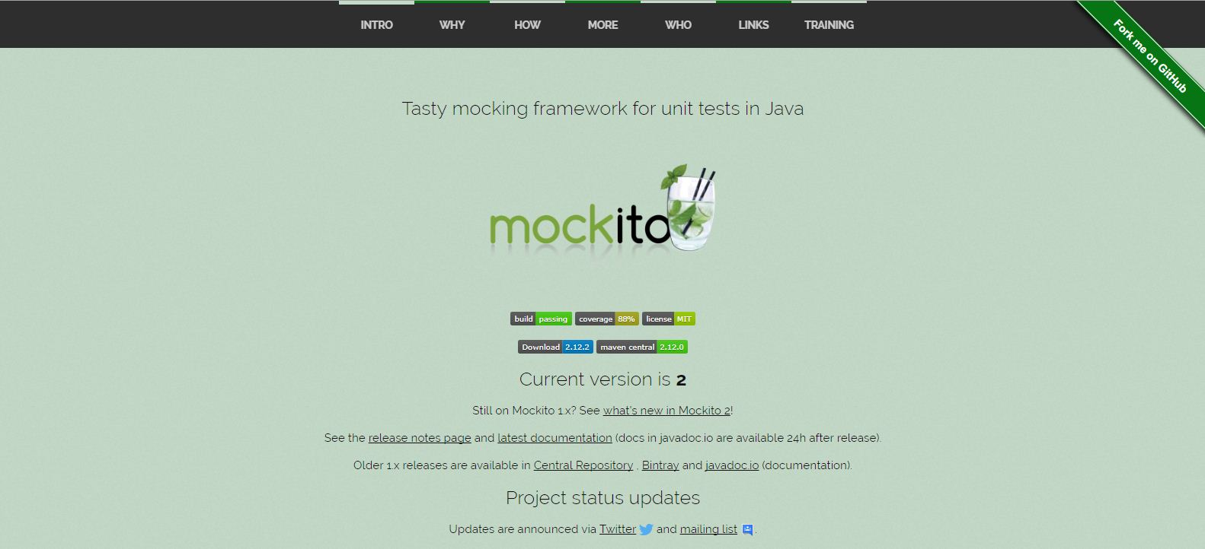
Mockito framework
Site: http://site.mockito.org/

Slide 9
Mockito framework. Create a mock
How to create:
1) Element mockedElement = mock(Element.class);
2) @Mock
Element mockedElement;
Mock creation:
Initial class:
public class Element {
public String getField() {
return field;
}
public void method() {
}
}
Mocked class:
public class MockedElement extends Element {
@Override
public String getField() {
return null;
}
@Override
public void method() {
}
}

Slide 10

Mockito framework. Create a spy
How create:
1) Element element = new Element();
Element spyElement = spy(element);
2) @Spy
Element spyElement = new Element();
Spy creation:
Initial class:
public class Element {
public void method() {
}
}
Mocked class:
public class SpiedElement extends Element {
@Override
public void method() {
spiedMethod();
super.method();
}
}

Slide 11

Test with spy usage
public class Owner {
public CatFood getCatFood() {
return catFood;
}
}
public class Cat {
public void askFood(Owner owner) {
owner.getCatFood();
}
}
Test
private Owner owner = new Owner();
private Owner spiedOwner = spy(owner);
@Test
public String askFoodTest () {
Cat cat = new Cat();
cat.askFood(spiedOwner);
Mockito.verify(owner, times(3)).getCatFood();
}

Slide 12

BDD Mockito.
My BDD is better than yours
Mockito
Your framework

Slide 13
BDD Mockito.
Can use key words:
given
when
then
String outputValue = “someOutputValue”;
String expectedResult = outputValue;
@Mock
private ExternalSystemElement element;
@Test
public String doSomething () {
given(element.isExists()).then(invocationOnMock -> true);
when(element.getValue()).thenReturn(outputValue);
SystemUnderTest systemUnderTest = new SystemUnderTest();
ValueDto value = systemUnderTest. doSomething(element);
assertThat(expectedResult, value.getAddress());
}
}

Slide 14
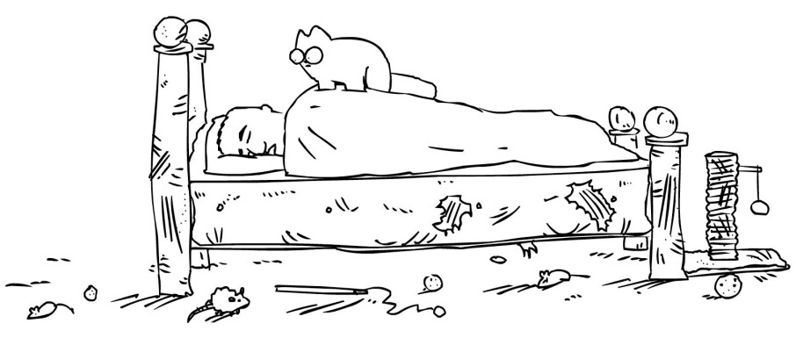
Mockito framework. Verify method
Household duties:
feed the cat;
play with cat;
cleaning.
doHouseholdDuties()
playWithCat()
Expected
Actual
Method playWithCat() has been never called.

Slide 15
Mockito framework. Verify method
To verify play() method call:
Mockito.verify(owner).play();
public class Owner {
public void doHouseholdDuties() {
play();
}
}
Test
public class SystemUnderTest {
public void doSomething(Owner owner) {
owner.doHouseholdDuties();
}
@RunWith(MockitoJUnitRunner.class) public class TestedSystemTest { @Mock private Owner owner; @Test public void doSomethingTest() { SystemUnderTest system = new SystemUnderTest(); system.doSomething(owner); Mockito.verify(owner).play();
}
}

Slide 16


Mockito framework. Count of method call
Household duties:
feed the cat (breakfast);
feed the cat (lunch);
feed the cat (dinner).
3 times: feedTheCat()
doHouseholdDuties()
feedTheCat()
Expected
Actual
breakfast
lunch
dinner
breakfast
lunch
dinner
Method feedTheCat() was called only 1 time.

Slide 17

Mockito framework. Count of method call
To verify someMethod() call several times:
Mockito.verify(instance, times(n)).someMethod()
public class Owner {
public void feedTheCat() {
}
}
public class SystemUnderTest {
public void doHouseholdDuties(Owner owner) {
owner.feedTheCat();
}
Test
@RunWith(MockitoJUnitRunner.class) public class TestedSystemTest { @Mock private Owner owner; @Test public void doSomethingTest() { TestedSystem system = new TestedSystem(); system.doHouseholdDuties(owner); Mockito.verify(owner, times(3)).feedTheCat();
}
}

Slide 18

Mockito framework. Throw exceptions
Mockito can throw exception for you!

Slide 19

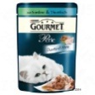

Mockito framework. Throw exceptions
public class Owner{
public CatFood getCatFood() throws OwnerGoToSleepException {
return catFood;
}
}
public class Cat {
public String askFood(Owner owner) {
try {
return owner.getCatFood();
} catch (OwnerGoToSleepException) {
return result;
}
}
}
Test
@RunWith(MockitoJUnitRunner.class) public class CatSystemTest {
public static String expectedResult;
@Mock private Owner owner; @Test public void askFoodTest() {
when(owner.getCatFood()).thenThrow(new OwnerGoToSleepException()); Cat cat = new Cat(); String actualResult = cat.askFood(owner); assertEquals(expectedResult, actualResult);
}
}

Slide 20

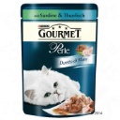




Mockito framework. Argument matchers
any() - matches anything, including null.
anyBoolean(), anyByte(), anyChar(), anyCollection(), anyDouble(), anyInt(), anyString(), …
public class Owner {
public CatFood getCatFood(String catFoodTrademark) {
return result;
}
}
?
Trademarks:
Owner owner = mock(Owner.class);
when(owner.getCatFood(anyString())).thenReturn(outputValue);

Slide 21
Mockito framework. Argument matchers
eq() - argument that is equal to the given value.
public class Owner {
public CatFood getCatFood(String catFoodTrademark) {
return result;
}
}
?
Just
ExternalSystemElement owner = mock(ExternalSystemElement.class);
when(owner.getCatFood(eq(“Value”))).thenReturn(outputValue);

Slide 22



Mockito. InvocationOnMock
+
getCatFood()

Slide 23



Mockito. InvocationOnMock
public class Owner {
public CatFood getCatFood(String firstDish, String secondDish) {
CatFood catFood = new CatFood();
catFood.setFirstDish(firstDish);
catFood.setSecondDish(secondDish);
return catFood;
}
}
+
public class Cat {
public String askFood(Owner owner, String firstDish, String secondDish) {
owner.getCatFood(firstDish, secondDish);
return result;
}
}
Test
@Mock
private Owner owner;
private CatFood getFood(InvocationOnMock invocation) {
Object[] args = invocation.getArguments();
CatFood catFood = new CatFood();
catFood.setFirstDish(args[0]);
catFood.setSecondDish(args[1]);
return catFood;
}
@Test
public String askFoodTest () {
when(owner.getCatFood(anyString(),eq(“Purina”))).thenAnswer(invocation -> getFood(invocation))
Cat cat = new Cat();
assertThat(expectedResult, cat.askFood(owner, “Gourmet”, “Purina”));
}
}

Slide 24

Mockito and static methods
Static method
Your tests
with Mockito

Slide 25
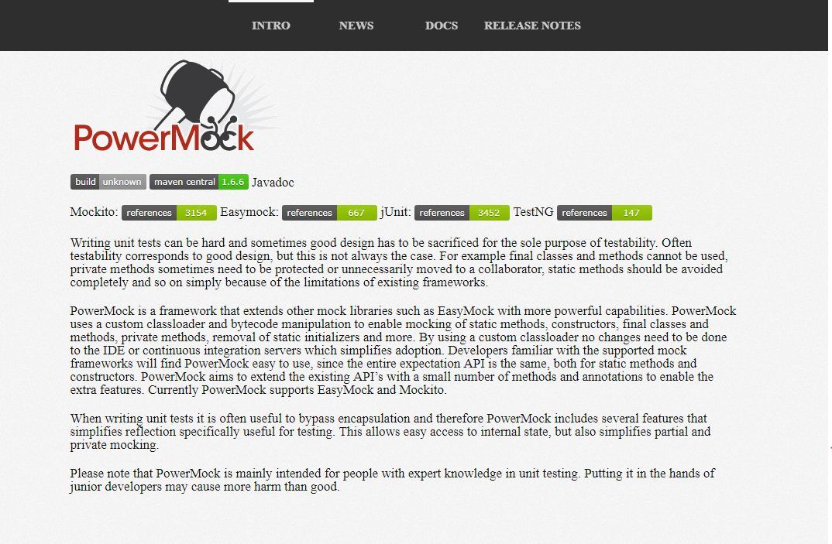
PowerMock framework
Site: http://powermock.github.io/

Slide 26

PowerMock and static methods
Your tests with
PowerMock
Static method

Slide 27


PowerMock framework. Mock static method
public class Owner {
public static CatFood getCatFood() {
return result;
}
}
public class Cat{
public String askFood() {
Owner.getCatFood();
return result;
}
}
Test
@RunWith(PowerMockRunner.class)
@PrepareForTest(Owner.class)
public class CatSystemTest {
String expectedResult = custom expected result;
String outputValue= expected output value;
@Test
public String askFoodTest () {
PowerMockito.mock(Owner.class);
when(Owner.getCatFood()).thenReturn(new CatFood());
Cat cat = new Cat();
String actualResult = cat.askFood();
assertEquals(expectedResult, actualResult);
}
}

Slide 28
WireMock framework
WireMock - библиотека для создания заглушек над веб-сервисами. Он создает HTTP-сервер, к которому мы могли бы подключиться, как к реальному веб-сервису.
Настройка сервера:
WireMockServer wireMockServer = new WireMockServer(String host, int port);
Если аргументы не предоставлены, по умолчанию для хоста сервера используется localhost , а для порта сервера - 8080 .
wireMockServer.start();
wireMockServer.stop();
<dependency>
<groupId>com.github.tomakehurst</groupId>
<artifactId>wiremock</artifactId>
<version>1.58</version>
<scope>test</scope>
</dependency>

Slide 29
WireMock framework
Заглушаем сервис:
configureFor("localhost", 8080);
stubFor(get(urlEqualTo("/baeldung")).willReturn(aResponse().withBody("Welcome to Baeldung!")));
stubFor(get(urlPathMatching("/baeldung/.** "))
.willReturn(aResponse()
.withStatus(200)
.withHeader("Content-Type", "application/json")
.withBody("\"testing-library\": \"WireMock\"")));
Пример вызова с Apach HttpClient:
CloseableHttpClient httpClient = HttpClients.createDefault();
HttpGet request = new HttpGet("http://localhost:8080/baeldung");
HttpResponse httpResponse = httpClient.execute(request);

Slide 30
JAVA Core
GIT
OOP
Java core
Data parsing & JSON
Junit
Lombok
Streams
Abstract class
Interface
Patterns: Singleton, Factory, Generator, Context e.t.c.
REST testing
HTTP requests
CRUD, REST
Authentication and authorization REST Assured
Practice with swagger
Web console
JDBC
Mocks and Stubs: Mockito, PowerMock, WireMock
UI testing
HTML
CSS
DOM
Locators (css, xpath e.t.c.)
Selenium
WebDriver
Selenide
Awaiting
Pattern: PageObject
BDD framework: Gauge

